Slide 1
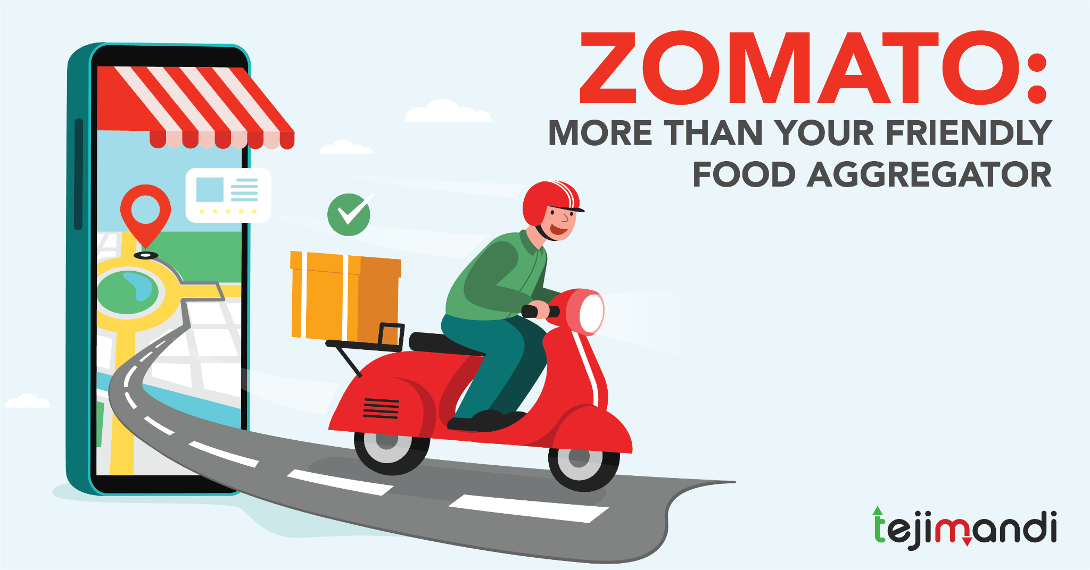

Zomato Restaurants Expansion Analysis
Puja Chowdhury
21/01/2025

Slide 2
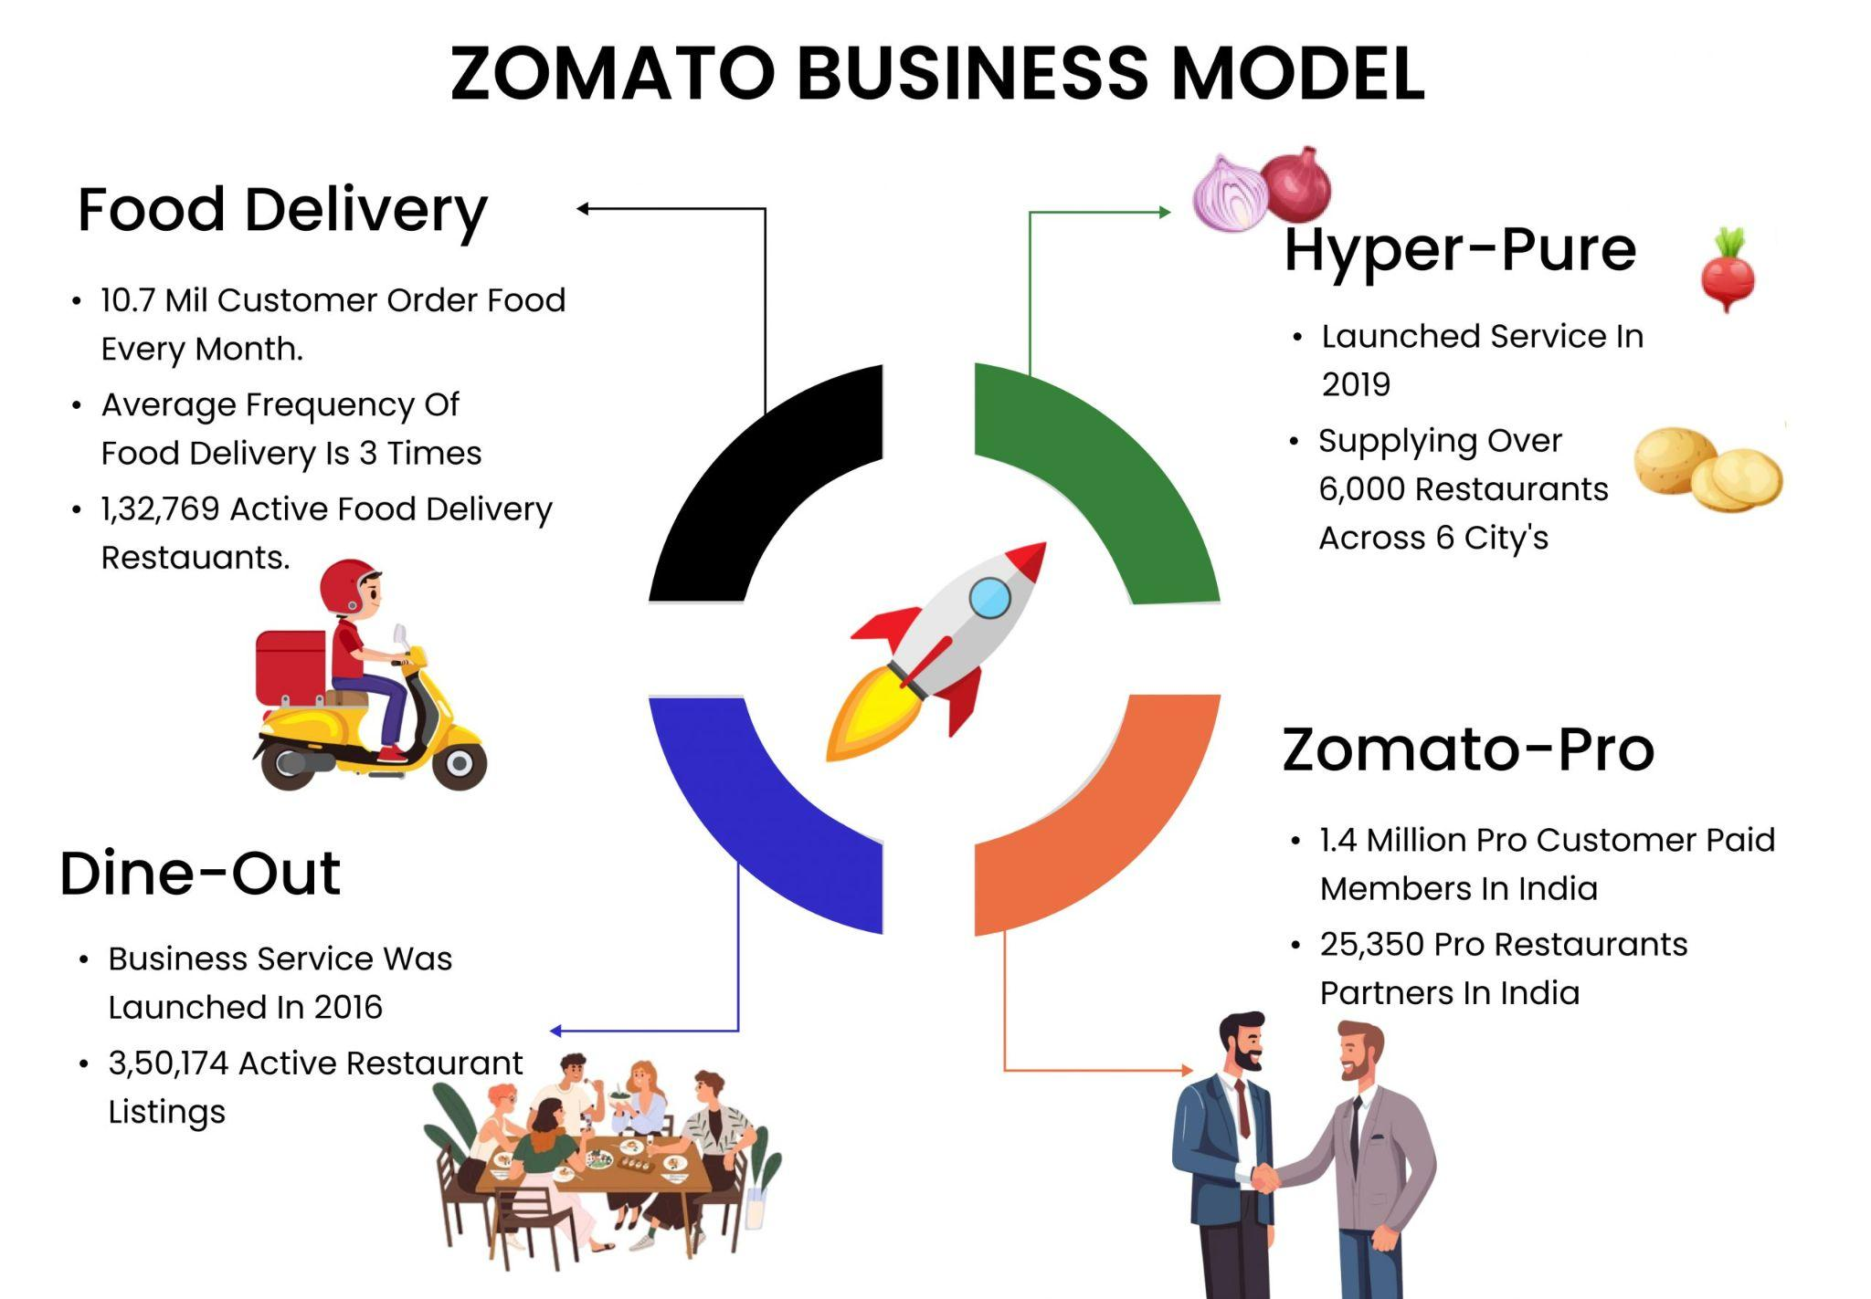
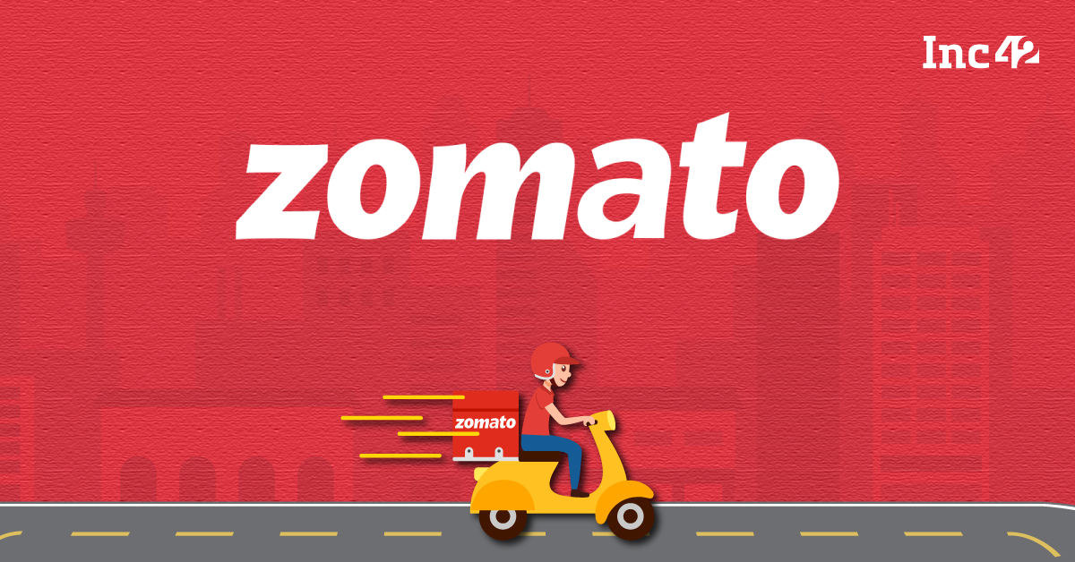
About Zomato
Better food for more people
scroll for more
Did you know? The global food delivery market is expected to grow by $186.5 billion from 2021 to 2026, highlighting immense growth opportunities for restaurant chains.
Zomato, a leader in the food-tech industry, is positioned to capitalize on this growth by expanding its restaurant network in key markets.

Slide 3
Project Objective
This analysis aims to identify potential areas for expansion, understand evolving market trends, and enhance restaurant partnerships.
Analyze Market Trends:
Understand customer preferences, spending patterns, and competitor activity.
Optimize Zomato’s Restaurant Portfolio
Develop strategies to enhance restaurant offerings, improve customer engagement, and increase market share.
Identify Key Areas for Expansion:
Pinpoint regions and cities with the highest potential for new restaurant openings.
This approaches blends a surprising industry fact with the clear goals of our project, setting the stage for your subsequent analysis and strategy development.

Slide 4
Summary of the data sets
Key Data Points:
Total Restaurants: 9551 entries spanning multiple countries.
Geographical Coverage:
15 countries and 141 cities.
Attributes Analyzed:
Location Data: CountryCode, City, Address, Longitude, Latitude.
Features Offered: Has_Table_booking, Has_Online_delivery.
Customer Feedback: Rating, Votes.
Why This Data Matters:
Provides actionable insights for identifying potential markets for expansion.
Helps understand customer preferences and pricing strategies.
High quality data is crucial for analyzing customer behaviour and seller performance.

Slide 5
Description of analytical methods and tools used.
Data Cleaning:
- Removed duplicate entries based on Restaurant ID.
- Standardized Currency values to INR for uniformity across countries.
Data Enrichment:
- Mapped CountryCode to corresponding country names for better readability.
Types of Analysis:
- Statistical Analysis: Analyzed Votes, Rating, and Average_Cost_for_two to identify high-performing restaurants.
- Trend Analysis: Studied patterns in Cuisines preferences and regional demand.
- Geospatial Analysis: Used city and locality data to identify areas with high restaurant density and customer engagement.

Slide 6
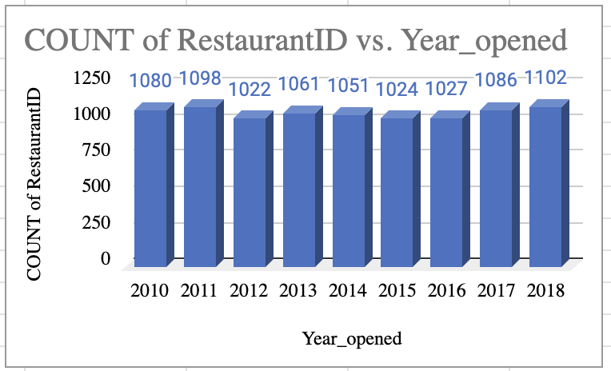
Year-wise Analysis of Restaurant Growth
Count of Restaurants:
Steady growth in restaurant openings from 2010 to 2018, peaking at 1102 in 2018.
Indicates consistent expansion trends over the years.
This shows stable expansion and consistent customer engagement over the years.

Slide 7
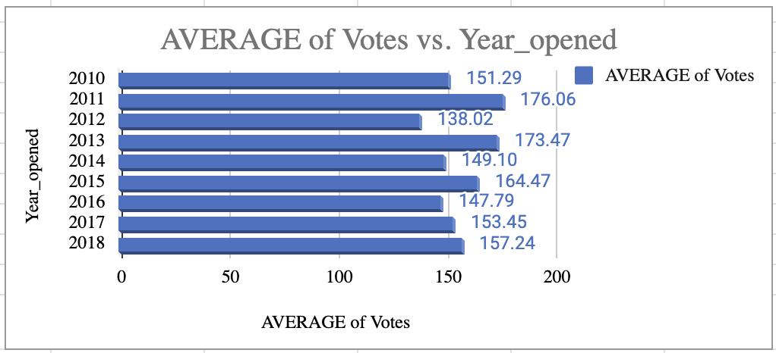
Year-wise Analysis of Customer Engagement
Average Votes:
Highest engagement in 2011 (176.05 votes); lowest in 2012 (138.02 votes).
Grand average of 156.91 votes reflects moderate customer interaction overall.

Slide 8
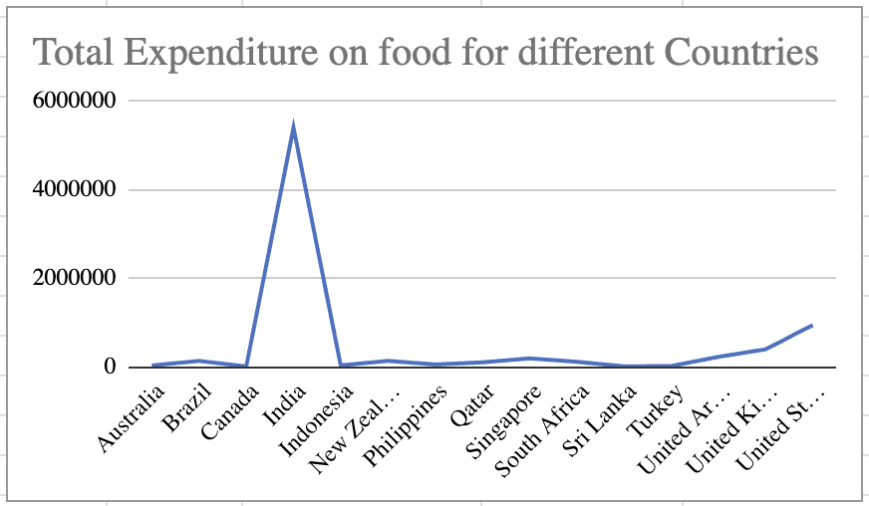
Facts from Total Expenditure on food
Australia & Canada: High food expenditures, especially in urban areas, indicating demand for premium dining.
Singapore: Diverse pricing; premium dining is popular.
Sri Lanka: Lower expenditures but evolving, with rising demand in urban areas.

Slide 9
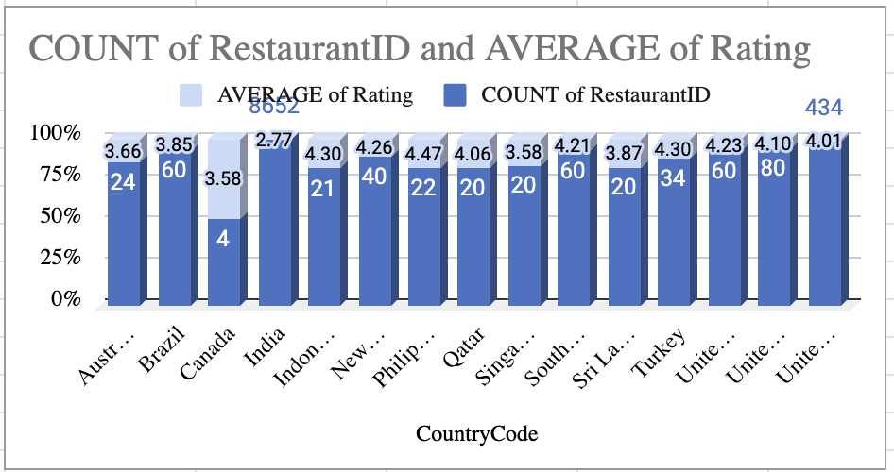
Findings from Ratings and Restaurant Engagement
Countries with fewer restaurants and high ratings indicate low competition markets with strong customer demand.
High population-to-restaurant ratios highlight growth potential in underserved areas.
Diverse price options suggest opportunities to target both budget and premium customer segments.

Slide 10
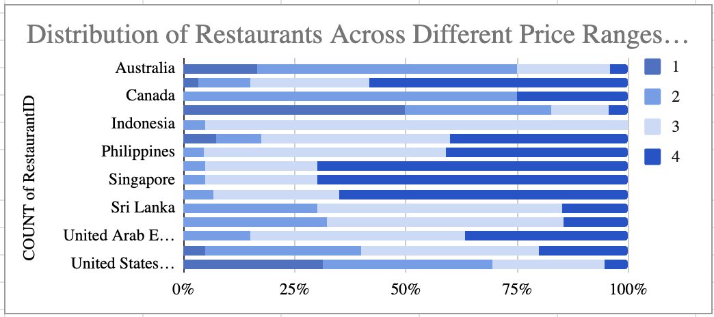
Market Potential Insights for Restaurant Growth
Australia, Canada, and Singapore are ideal for expansion due to increasing urban populations and middle-class growth.
Sri Lanka and Indonesia present emerging opportunities due to a growing demand for dining experiences and lower competition.
Smaller cities provide an advantage in terms of lower competition and higher potential for market entry.

Slide 11
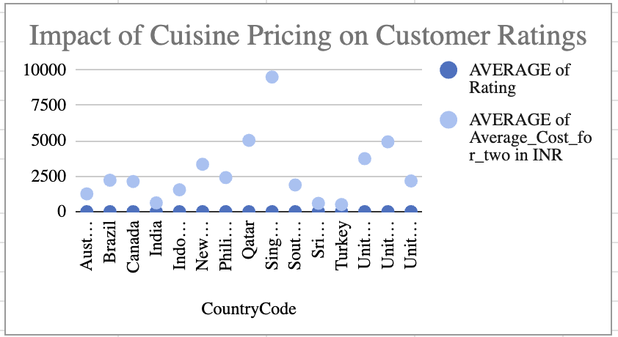
Reflections from Consumer Preferences
Australia, Canada, and Singapore are leaning towards fusion and local cuisines, signaling a demand for unique dining experiences.
SriLanka shows a strong demand for affordable international cuisines, catering to price-sensitive diners.
The increasing trend of diverse food offerings calls for restaurants to consider regional preferences when choosing their menu.

Slide 12
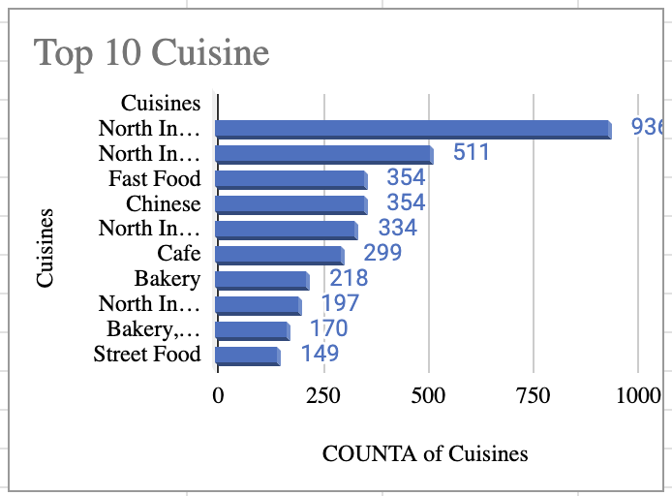
Reflections from Cuisine Trends
Global Appeal: Indian cuisines consistently rank among the most preferred, showcasing their global acceptance.
Regional Favorites: Some cuisines perform exceptionally well in specific countries or regions, highlighting localized preferences.
Expansion Strategy: Introducing these cuisines in underrepresented regions could attract more customers and improve engagement.

Slide 13
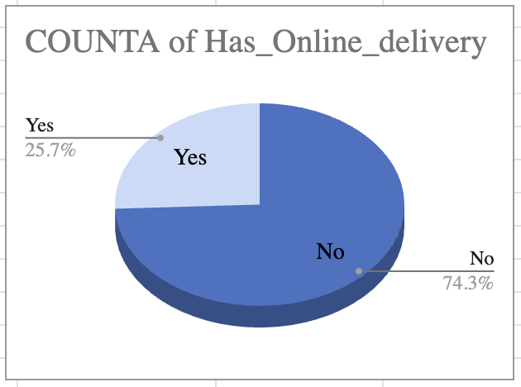
A Look at Online Delivery Service Features
Lifestyle Fit: Supports modern lifestyles with quick, accessible meals.
Strategic Impact: Expanding delivery options can boost visibility, engagement, and revenue.
Target Audience: Younger demographics and working professionals drive demand for convenience.

Slide 14
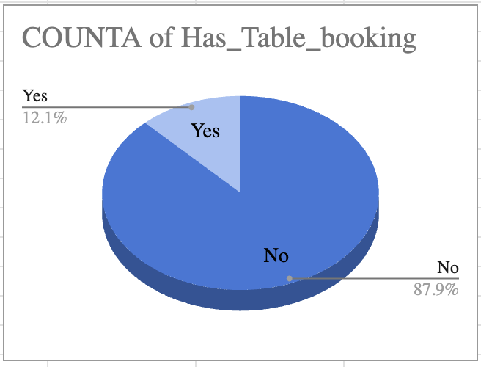
Perspectives from Table Reservation Service Features
Crowd Management: Helps premium establishments maintain a seamless dining experience and improve operational efficiency.
Catering to Premium Segments: Targeting high-end markets with table booking boosts customer satisfaction and loyalty.
Urban Market Strategy: Table booking in city centers complements Zomato’s strategy to attract discerning diners in competitive areas.
Higher Ratings Correlation: Restaurants with online delivery options receive better ratings, highlighting the convenience factor.

Slide 15
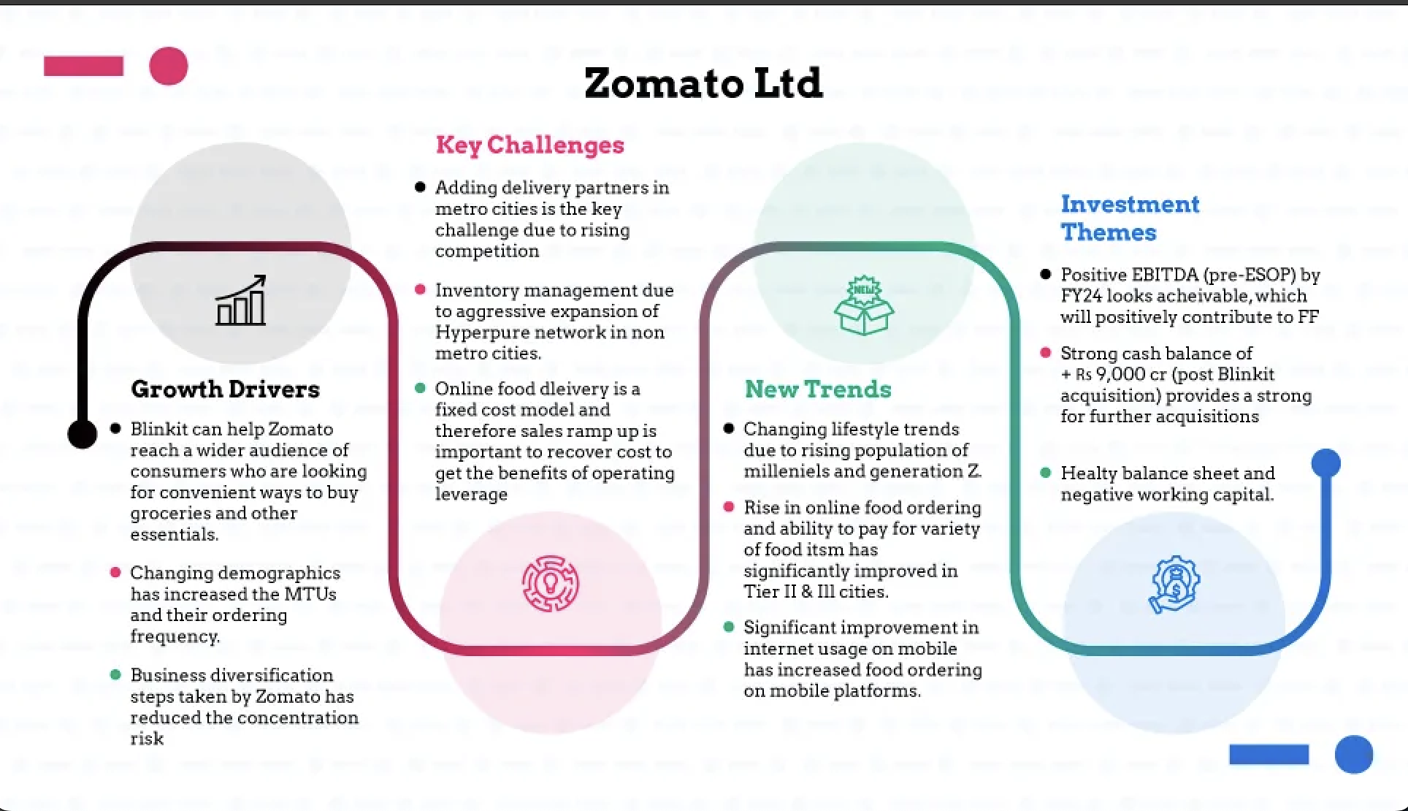
Strategic Recommendations
Key Insights:
High Online Delivery Demand:
Restaurants with online delivery options consistently achieve higher ratings and order volumes.
Mid-Price Range Preference:
Most customers prefer restaurants in the mid-price range, offering affordability and quality balance.

Slide 16
Strategic Recommendations
Strategic Recommendations
Focus on Online Delivery:
Partner with restaurants offering online delivery to drive higher customer satisfaction.
Target Tier-2 Cities:
Expand into tier-2 cities to capture growing demand and reduce reliance on metros.
Promote Mid-Priced Restaurants:
Encourage partnerships with restaurants in the mid-price range to attract broader audiences.
Diversify Cuisine Offerings:
Onboard restaurants with healthy and vegan options to cater to emerging trends.
Optimize Logistics in Smaller Cities:
Improve delivery networks in underserved areas to enhance customer experience.

Slide 17
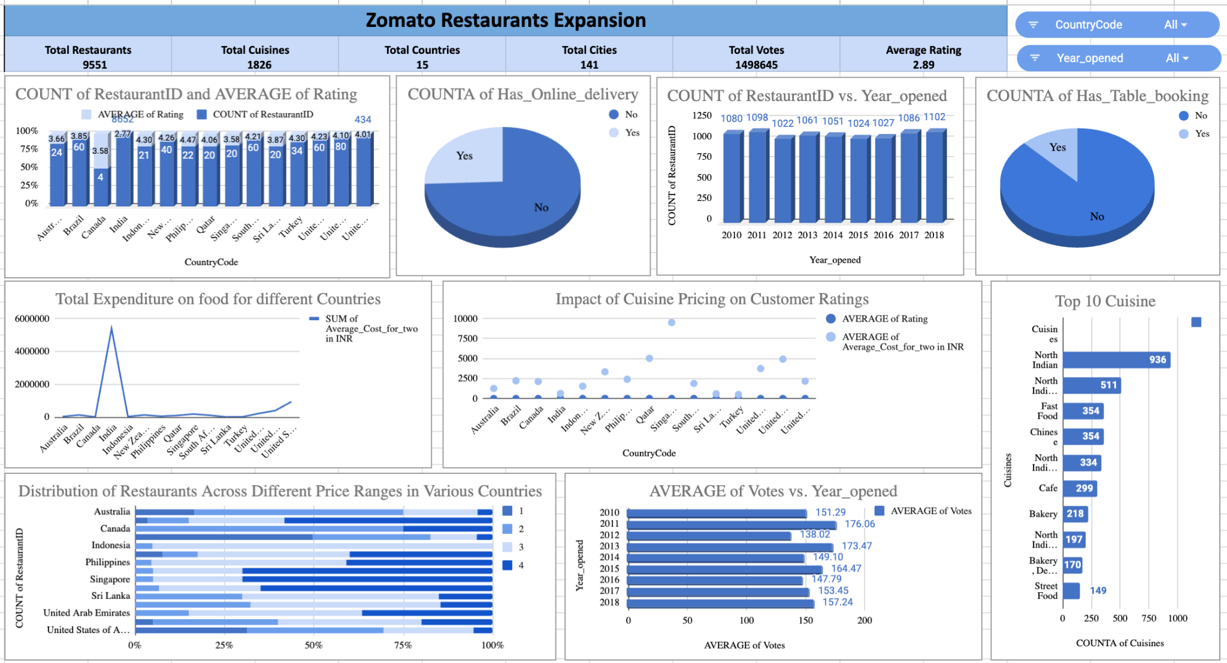
Dashboard and Visualizations

Slide 18
Dashboard and Visualizations
Key Insides :
Lesser Competition: Countries like Sri Lanka (3.9 rating) and Australia (24 restaurants) show strong potential for expansion.
Suggested Countries: High customer satisfaction in Sri Lanka, Australia, and Singapore indicates strategic opportunities.
Expenditure: Sri Lanka has the highest customer spending (47,500 LKR), making it a lucrative market.
Pricing vs. Rating: Higher pricing slightly improves ratings but isn’t a direct factor for satisfaction.
Price Range: Most restaurants operate in the lowest price range, suggesting affordability trends.

Slide 19
Dashboard and Visualizations
Interactive Features in the Dashboard :
Filters and Slicers:
Country Filter: Enables users to focus on data for specific countries, such as analyzing restaurant performance, ratings.
Year Filter: Allows users to view trends over specific years, such as the number of restaurants opened or changes in ratings.
Dynamic Visualizations:
The "Impact of Online Delivery and Table Booking" pie chart provides insights into customer preferences, and filters refine this by country.
Custom Interactivity: Slicers allow quick exploration of metrics like total restaurants, cuisines, and price ranges, tailoring the analysis to specific needs.

Slide 20
Conclusion
These findings provide a data-driven foundation for Zomato’s strategic expansion, ensuring optimized operations and enhanced customer satisfaction in target markets.
Restaurant Distribution:
India dominates with the highest restaurant count, but countries like Sri Lanka and Singapore show potential for expansion due to favorable competition and high ratings.
Market Opportunities:
Suggested countries like Australia, Canada, and Sri Lanka have untapped potential for growth, supported by data on ratings, expenditure, and customer trends.
Customer Preferences:
Price range and online delivery significantly influence customer satisfaction and engagement, making them crucial for strategic planning.
Zomato's analysis reveals India as a dominant market, with growth opportunities in Sri Lanka, Singapore, Canada, and Australia. Understanding customer preferences is crucial for success.

Slide 21
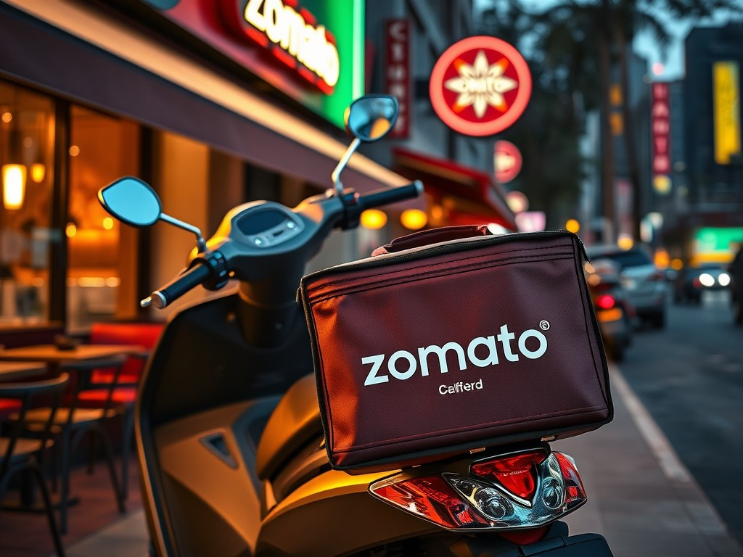
Reference
Newton school Data sets
Mentor - Santhosh Reddy Vemareddy
Teaching Asst - Vaishnavi Bhat
Currency Converter Rate : MARKETS.BUSINESSINSIDER.COM

